Slide 1
Degree in Computing Year 3 Rich Web Applications
Lecture 2 Javascript

Slide 2
This Week
Form Validation
Changing menus dynamically
Window Events
Mouse Clicks
Document Object Model

Slide 3
Changing Menus Dynamically
It's often useful to offer the user a choice of inputs via pop-up menus, and to be able to change the contents of one or more pop-up menus depending on the choice the user makes in another pop-up menu.
You've probably seen this on Web sites that ask you to choose the country you live in from a pop-up menu and then fill a second menu with state or county names, based on the choice you made.
In the following example we're using two pop-up menus . The first menu is for months.
When the user picks a month, the script populates the second pop-up menu with the correct number of days for the selected month.

Slide 4
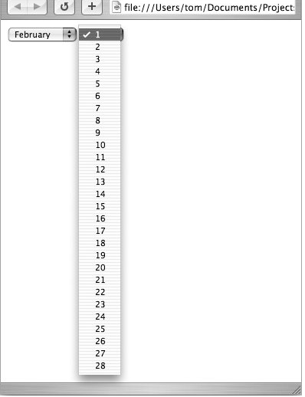
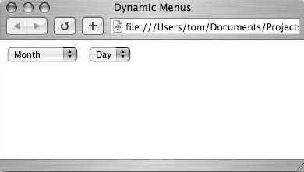
Changing Menus Dynamically
Example execution
The contents of the Day menu are filled in automatically when the user makes a selection from the Month menu.

Slide 5
Changing Menus Dynamically
script.html
<html>
<head>
<title>Dynamic Menus</title>
<script type="text/javascript" src="script.js">
</script>
</head>
<body>
<form action="#">
<select id="months">
<option value="">Month</option>
<option value="0">January</option>
<option value="1">February</option>
<option value="2">March</option>
<option value="3">April</option>
<option value="4">May</option>
<option value="5">June</option>
<option value="6">July</option>
<option value="7">August</option>
<option value="8">September</option>
<option value="9">October</option>
<option value="10">November</option>
<option value="11">December</option>
</select>
Notes:
Chapter 7, c2

Slide 6
Changing Menus Dynamically
script.html (contd.)
&nbsp;
<select id="days">
<option>Day</option>
</select>
</form>
</body>
</html>html

Slide 7
Changing Menus Dynamically
script.js
window.onload = initForm;
function initForm() {
document.getElementById("months").selectedIndex = 0;
document.getElementById("months").onchange = populateDays;
}
function populateDays() {
var monthDays = new Array(31,28,31,30,31,30,31,31,30,31,30,31);
var monthStr = this.options[this.selectedIndex].value;
if (monthStr != "") {
var theMonth = parseInt(monthStr);
document.getElementById("days").options.length = 0;
for(var i=0; i<monthDays[theMonth]; i++) {
document.getElementById("days").options[i] = new Option(i+1);
}
}
}

Slide 8
Changing Menus Dynamically
Code Explanation
var monthDays = new Array(31,28,31,3 0,31,30,31,31,30,31,30,31);
This new array contains 12 values for the 12 months, with the correct number of days in each month. The array is stored in the variable monthDays
var monthStr = this.options [this.selectedIndex].value;
We're using this (the month the user picked from the first menu) to get the value from the menu, and storing it in monthStr

Slide 9
Changing Menus Dynamically
Code Explanation
if (monthStr != "") { var theMonth = parseInt(monthStr);
If the value of monthStr is "", then the user chose the word "Month" in the menu, rather than a month name. What these lines do is check to see that the value of monthStr is not ""; if that condition is true, then monthStr is turned into a number with the parseInt method, and the variable theMonth is set to the result.
document.getElementById("days"). options.length = 0; for(var i=0; i<monthDays[theMonth]; i++) { document.getElementById("days"). options[i] = new Option(i+1);
Start changing the day menu by setting its options length to zero. That clears out whatever happened to be there before, so we're starting fresh. The loop simply goes through the number of days in whatever the chosen month is, adding a new option to the menu for each day. Option is passed i+1, so that it shows 1 to 31 instead of 0 to 30.

Slide 10
Handling Window Events
Window events occur when the user does something affecting an entire browser window.
The most common window event is simply loading the window by opening a particular Web page.
You can also have events that trigger event handlers when windows are closed, moved, or even sent to the background.
When working with event handlers, you'll often find it useful to connect an event handler to an object using dot syntax, like so:
window.onfocus window.onload document.onmousedown

Slide 11
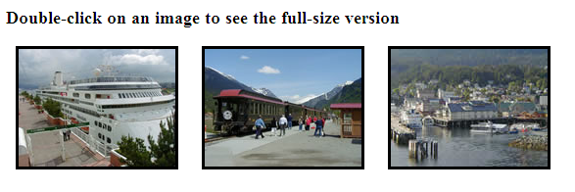
Handling Window Events – Mouse Clicks
In this example we are going to use the mouse click event so that if the image is double-clicked the full size pops up.

Slide 12
Handling Window Events – Mouse Clicks
script.html
<html>
<head>
<title>Image Popup</title>
<script type="text/javascript" src="script.js">
</script>
</head>
<body>
<h3>Double-click on an image to see the full-size version</h3>
<img src="images/Img0_thumb.jpg" width="160" height="120" hspace="10" border="3" alt="Thumbnail 0" id="Img0" />
<img src="images/Img1_thumb.jpg" width="160" height="120" hspace="10" border="3" alt="Thumbnail 1" id="Img1" />
<img src="images/Img2_thumb.jpg" width="160" height="120" hspace="10" border="3" alt="Thumbnail 2" id="Img2" />
</body>
</html>
Notes:
Chapter8, ex3

Slide 13
Handling Window Events – Mouse Clicks
script.js
window.onload = initImages;
function initImages() {
for (var i=0; i<document.images.length; i++) {
document.images[i].ondblclick = newWindow;
}
}
function newWindow() {
var imgName = "images/" + this.id + ".jpg";
var imgWindow = window.open(imgName, "imgWin", width=320,height=240,scrollbars=no");
}

Slide 14
Handling Window Events – Mouse Clicks
Code explanation – script.js
// when the page first loads call the function initImages
window.onload = initImages;
// this loops through all the images on the page and if an image is double-clicked
// the newWindow function is called
function initImages() {
for (var i=0; i<document.images.length; i++) {
document.images[i].ondblclick = newWindow;
}
}

Slide 15
Handling Window Events – Mouse Clicks
Code explanation – script.js
function newWindow() {
// this sets up the image name
var imgName = "images/" + this.id + ".jpg";
// open a new window and pass it the image name, the name of the window, // width and height
var imgWindow = window.open(imgName, "imgWin", "width=320,height=240,scrollbars=no");
}

Slide 16
DOM
Document Object Model

Slide 17
DOM
The DOM is an important part of understanding how javaScript and AJAX works
Everything in the browser window is an object
JavaScript organises all elements of the web page into an object hierarchy in order to allow the programmer to manipulate these objects.
This is known as the DOM

Slide 18
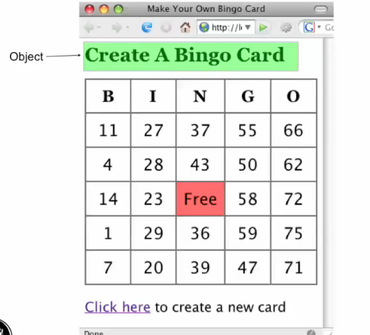
DOM
Lets look at the bingo card example:
The h1 is an object on the web page

Slide 19
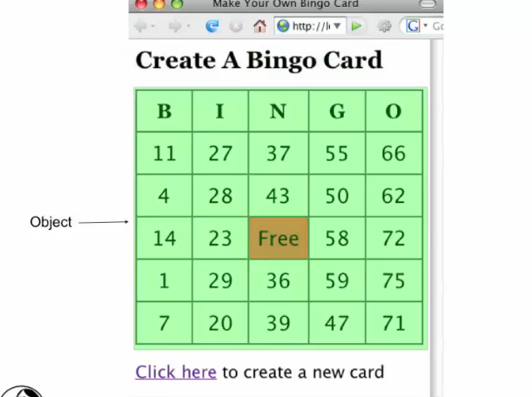
DOM
The table is an object on a web page

Slide 20
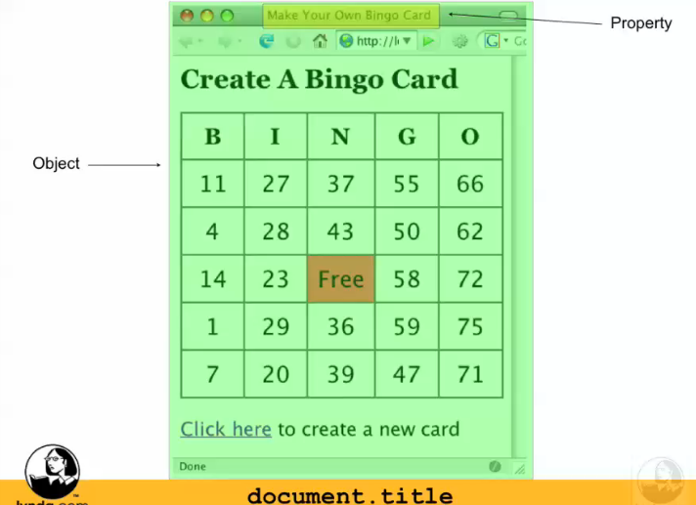
DOM
In fact the entire page is an object called document
Objects have things called properties
Properties are objects in their own right.
The title is a property of the document object called document.title

Slide 21
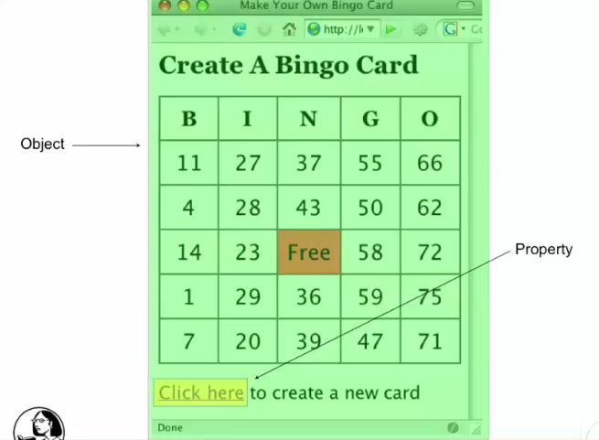
DOM
Similarly the link is a property of the document object called document.link

Slide 22
DOM
The table is a property of the document object called document.table
Each row is a property of the table object called table.row
Each cell is a property of the row object, row.cell
So you may be wondering how do we know what object/property is what within a given web page.
That where the DOM Inspector comes in handy!

Slide 23
DOM
What is the DOM Inspector
DOM Inspector is a tool that can be used to inspect and edit the live DOM of any web document.
The DOM can be navigated using a two-paned window displaying a variety of different views on the document and all nodes within.

Slide 24
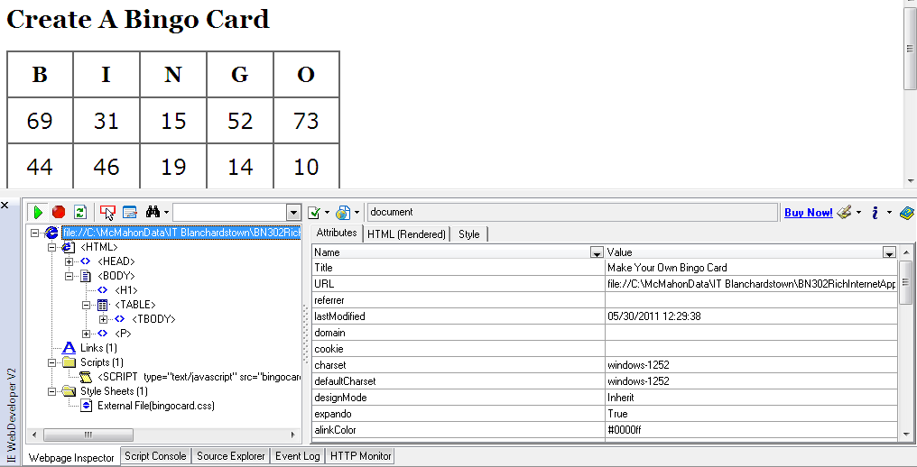
DOM
Lets look at the bingo card example:

Slide 25
DOM
For IE Explorer the DOM Inspector is available for download at:
http://www.ieinspector.com/dominspector/
For Firefox it is available to download at:
https://addons.mozilla.org/en-US/firefox/addon/dom-inspector-6622/

Slide 26
DOM
Lets look at an other example.
This example shows Stefan’s home page

Slide 27
DOM
There’s two images, one link, and one form with two text fields and a button.
Remember the browser window is a window-object.
An element of the window-object is the document-object (into which we have loaded a HTML page).
The document-object is an important object in JavaScript.
This document-object has various properties like background colour and so on.
Furthermore all of the HTML-elements are themselves properties of the document-object.
These HTML-elements (like the images, forms etc.) are themselves objects with their own properties.
So we have an object hierarchy as shown overleaf.

Slide 28
DOM
In order to refer to different objects on the page we must refer to this hierarchy.
Suppose we want to access the first image. This is
document.images[0]
Access the first text field of the form as
document.forms[0].elements[0]
or document.myForm.myText

Slide 29
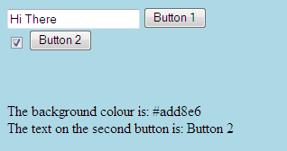
DOM
Lets look at a similar example:
This example has a textbox and 2 buttons one of which can be checked.

Slide 30
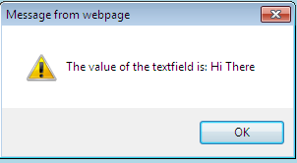
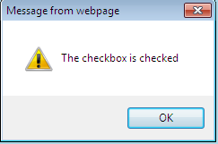
DOM
If you click on button1 the following is displayed:
If you click on button 2:

Slide 31
DOM
The code is as follows:
domex2.html
<html>
<head>
<script type="text/javascript" src="domex2.js"> </script>
</head>
<body bgcolor=lightblue>
<form name="myForm">
<input type="text" name="myText" value=“Hi There">
<input type="button" name="button1" value="Button 1"
onClick="first()">
<br>
<input type="checkbox" name="myCheckbox" CHECKED>
<input type="button" name="button2" value="Button 2"
onClick="second()">
</form>
<p><br><br>
</body> </html>

Slide 32
DOM
domex2.js
function first(){
//creates a popup window with the text which was
// entered into the text field
alert("The value of the textfield is: " +
document.myForm.myText.value);
}
function second(){
//this function checks the state of the checkbox
var myString="The checkbox is ";
if(document.myForm.myCheckbox.checked)myString+="checked"
else myString+="not checked";
alert(myString);
}
document.write("The background colour is: ");
document.write(document.bgColor + "<br>");
document.write("The text on the second button is: ");
document.write(document.myForm.button2.value);

Slide 33
DOM
Notes from Code
alert("The value of the textfield is: " + document.myForm.myText.value);
This takes the value from the textbox.
document.write(document.myForm.button2.value);
This writes the value of “button2” to the screen, ie “Button 2”

Slide 34
Summary
Form Validation
Changing menus dynamically
Window Events
Mouse Clicks
Document Object Model

